Slide 1
Springboard Data science Final project summary
Prepared by: Damian U. Emerson

Slide 2
Overview:
Introduction to the problem statement
Data science pipeline steps
Sourcing/loading the data
Cleaning, transforming/visualizing
Modelling
Evaluation/Conclusion(s)

Slide 3
Problem statement:
What is the problem?
Did Apple store apps receive better reviews than google play store apps; given the available datasets for each?
To solve this: We will make use of the data science pipeline steps….

Slide 4
Data science pipeline steps:
Sourcing/loading the data
Cleaning, transforming/visualizing
Modelling
Evaluating/Conclusion(s)

Slide 5
Sourcing/loading the data:
The source of the Apple play store and google play store datasets will be kaggle.com
Each dataset will be downloaded from the internet and loaded into a jupyter notebook
The pertinent columns of the datasets will be selected and subsetted accordingly

Slide 6
Sourcing/loading the data:
Google.head(3)
Apple.head(3)
https://www.kaggle.com/lava18/google-play-store-apps
https://www.kaggle.com/ramamet4/app-store-apple-data-set-10k-apps

Slide 7
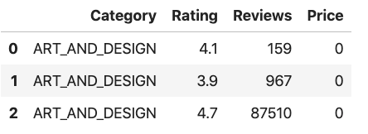
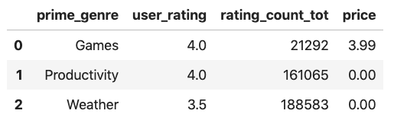
Sourcing/loading the data:
From the google total dataframe, the following subset of columns are considered important: Category(?), Rating, Reviews, Price (maybe)
From the apple total dataframe, the following subset of columns are considered important: prime_genre, user_rating, rating_count_tot, price (maybe)
Google = Google[['Category', 'Rating', 'Reviews', 'Price']] Apple = Apple[['prime_genre', 'user_rating', 'rating_count_tot', 'price']]
Google.head(3) Apple.head(3)

Slide 8
Cleaning, transforming/visualizing:
The Google and Apple dataframes will be cleaned, transformed and merged into one dataframe for easier comparison.
To do this, the data types for each column should be consistent with the data; float data entries should be classified as a “float column” and not an object
A new “platform” column will be added to both the Apple and Google dataframes
The names of the Apple dataframe columns will be changed to be consistent with the corresponding column names of the Google dataframe
Once the steps preceding this one are complete, the google an apple dataframes will be merged into one dataframe

Slide 9
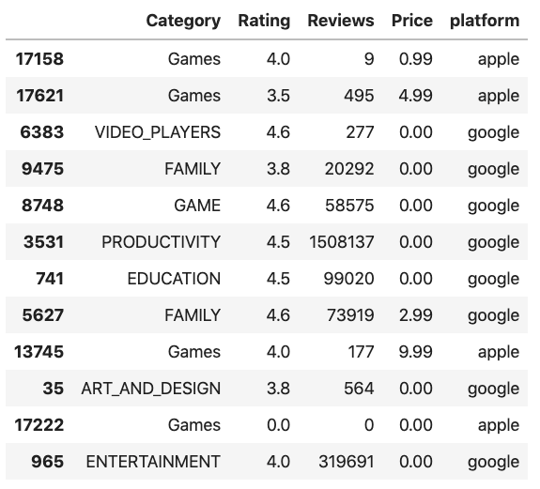
Cleaning, transforming/visualizing:
After the Apple and Google data frames have been individually cleaned, they will be merged together accordingly.
df = Google.append(Apple, ignore_index= True) #Used to append the apple data (Apple) to the end of the google dataframe (Google)
df.sample(12) #Used to check 12 random datapoints of the complete dataframe

Slide 10
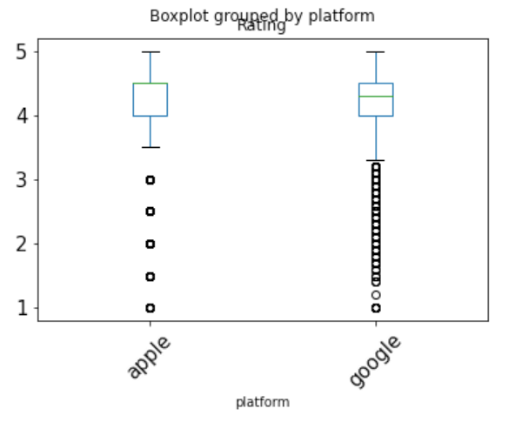
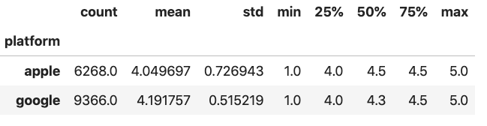
Cleaning, transforming/visualizing:
After removing any app data with N/A data points, df = df.dropna() and removing any app data that hasn’t been reviewed, i.e df = df[df['Reviews'] != 0], on the reviews column regardless of app platform
We can then do a summary visualization of parameters such as “mean” and “standard deviation” on the total dataframe data grouped by the app “platform” as well as view the data on a boxplot
df.groupby(by='platform')['Rating'].describe() df.boxplot( by='platform', column = ['Rating'], grid=False, rot=45, fontsize=15)

Slide 11
Modelling:
In our modelling step, we propose the following set of null and alternative hypotheses:
Null hypothesis (Ho): the observed difference in the mean rating of Apple Store and Google Play apps [(4.191757 - 4.049697) = 0.14206], is due to chance (and thus not due to the platform)
Alternative hypothesis (Ha): the observed difference in the average ratings of apple and google users is not due to chance (and is actually due to platform).
We will pick a significance level of 0.05...
Notes:
Outline of our method:
We'll assume that platform (i.e, whether the app was Google or Apple) really doesn’t impact on ratings.
Given this assumption, we should actually be able to get a difference in mean rating for Apple apps and mean rating for Google apps that's pretty similar to the one we actually got (0.14206) just by: a. shuffling the ratings column, b. keeping the platform column the same, c. calculating the difference between the mean rating for Apple and the mean rating for Google.
We can make the shuffle more useful by doing it many times, each time calculating the mean rating for Apple apps and the mean rating for Google apps, and the difference between these means.
We can then take the mean of all these differences, and this will be called our permutation difference. This permutation difference will be great indicator of what the difference would be if our initial assumption were true and platform really doesn’t impact on ratings.
Now we do a comparison. If the observed difference looks just like the permutation difference, then we stick with the claim that actually, platform doesn’t impact on ratings. If instead, however, the permutation difference differs significantly from the observed difference, we'll conclude: something's going on; the platform does in fact impact on ratings.
As for what the definition of significantly is, we'll get to that. But there’s a brief summary of what we're going to do. Exciting!

Slide 12
Modelling:
With the hypothesis tests and significance level defined, the next step will be to choose the appropriate statistical test for evaluating our null and alternative hypotheses
To select the appropriate statistical test, the distribution of the data to be evaluated will need to be determined
The stats.normaltest() method is used for determining if a dataset is normally distributed
The null hypothesis of the normaltest() is that the data are normally distributed, the lower the p-value in the result of this test, the more likely the data are to be non-normal.
apple = df[df['platform'] == 'apple']['Rating'] ; apple_normal = stats.normaltest(apple)
google = df[df['platform']== 'google']['Rating'] ; google_normal = stats.normaltest(google)

Slide 13
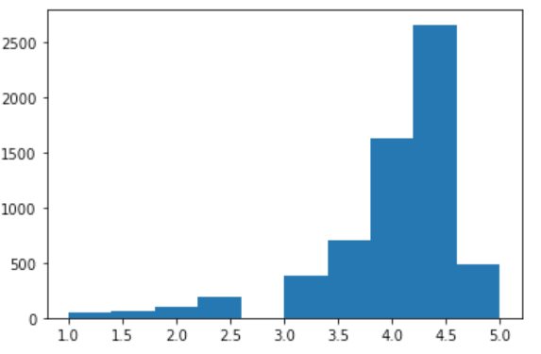
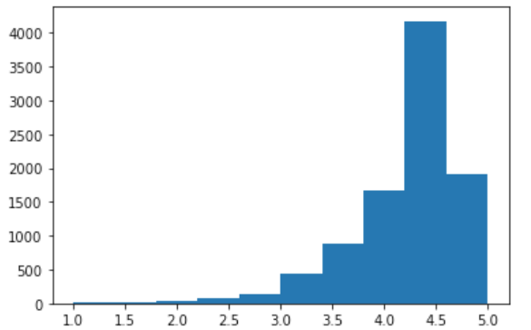
Modelling:
After utilizing the stats.normaltest() method we get the below results:
print(apple_normal)
NormaltestResult(statistic=1778.9974234584017, pvalue=0.0)
print(google_normal)
NormaltestResult(statistic=3678.6157187516856, pvalue=0.0)
histoApple = plt.hist(apple) histoGoogle = plt.hist(google)

Slide 14
Modelling:
Since both the apple and google datasets are both non-normally distributed, a nonparametric statistical test will be utilized
The permutation test is a nonparametric test used to test the null hypothesis that two different groups come from the same distribution
A new column “Permutation1” will be added to the total dataframe df, which will contain the result of permuting(shuffling) the Rating column
df['Permutation1'] = np.random.permutation(df['Rating'])

Slide 15
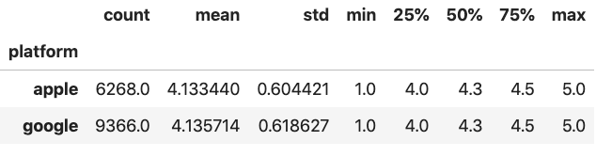
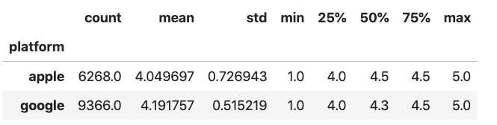
Modelling:
We can compare the differences in mean rating of apple and google for both the new “Permutation1” column and the old “Ratings” column
df.groupby(by='platform')['Permutation1'].describe() df.groupby(by='platform')['Rating'].describe()
vvdvvdvdvdvsvsvsadvsdvsdavsda
diff_mean(apple_google) = 0.00227
diff_mean(apple_google) = 0.14206

Slide 16
Modelling:
The result of the permutation test in one instance supports the claim to reject our original null hypothesis.
In order to conclude definitively, multiple permutations would need to be computed and the differences in the mean apple and mean google datasets would need to vary greatly from the observed difference of 0.14206

Slide 17
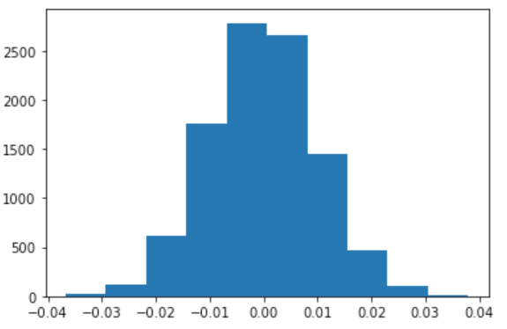
Modelling:
We choose to compute 10,000 permutations
difference = list()
for i in range(10000):
permutation = np.random.permutation(df['Rating'])
difference.append(np.mean(permutation[df['platform']=='apple']) - np.mean(permutation[df['platform']=='google']))
histo = plt.hist(difference)

Slide 18
Modelling:
In order to make a conclusion, we're going to count how many of the differences in our difference list are at least as extreme as our observed difference of 0.14206.
If less than or equal to 5% of them are, then we will reject the Null.

Slide 19
Modelling:
Python Code block:
positiveExtremes = []
negativeExtremes = []
for i in range(len(difference)):
if (difference[i] >= obs_difference):
positiveExtremes.append(difference[i])
elif (difference[i] <= -obs_difference):
negativeExtremes.append(difference[i])
print(len(positiveExtremes))
print(len(negativeExtremes))
0
0

Slide 20
Evaluation/Conclusion(s):
The main points to take away in our evaluation:
Zero differences are at least as extreme as our observed difference!
The p-value of our observed data is 0
It doesn't matter which significance level we pick; our observed data is statistically significant, and we reject the Null.
Conclusion(s):
The platform does impact on ratings. Specifically, we should advise our client to integrate only Google Play into their operating system interface.

